Slide 1
PROJECT TITLE SECURE DATA HIDING IN IMAGES USING STEGANOGRAPHY
CAPSTONE PROJECT
Presented By:
Student Name : BALAJI BODICHARLA
College Name & Department : SIDDHARTHA INSTITUTE OF ENGINEERING AND TECHNOLOGY(FINAL YEAR CSE DEPT.)

Slide 2
OUTLINE
Problem Statement
Technology used
Wow factor
End users
Result
Conclusion
Git-hub Link
Future scope

Slide 3
Problem Statement
Identifies the current issue with visible encrypted communications
Points out limitations in existing solutions
Highlights the need for user-friendly security tools
Presents our solution's key features
Emphasizes the practical application

Slide 4
Technology used
Python 3.13.2 as the primary programming language
Key Libraries:
Pillow (PIL) for image processing
NumPy for array manipulation and data handling
Cryptography for secure password-based encryption
Tkinter for creating the graphical user interface
Threading for responsive UI during operations
LSB (Least Significant Bit) steganography technique
Fernet symmetric encryption for message security

Slide 5
Wow factors
Modern, intuitive graphical user interface
Real-time image preview functionality
Password-protected encryption for enhanced security
Support for multiple image formats (PNG, JPG, JPEG, BMP)
Progress indicators for long operations
Error handling with user-friendly messages
Image signature verification to prevent tampering
Threaded operations for smooth user experience

Slide 6
End users
Privacy-conscious individuals
Organizations dealing with sensitive information
Students learning about cryptography and steganography
Professionals requiring secure communication channels
Digital forensics practitioners
Security researchers and enthusiasts

Slide 7
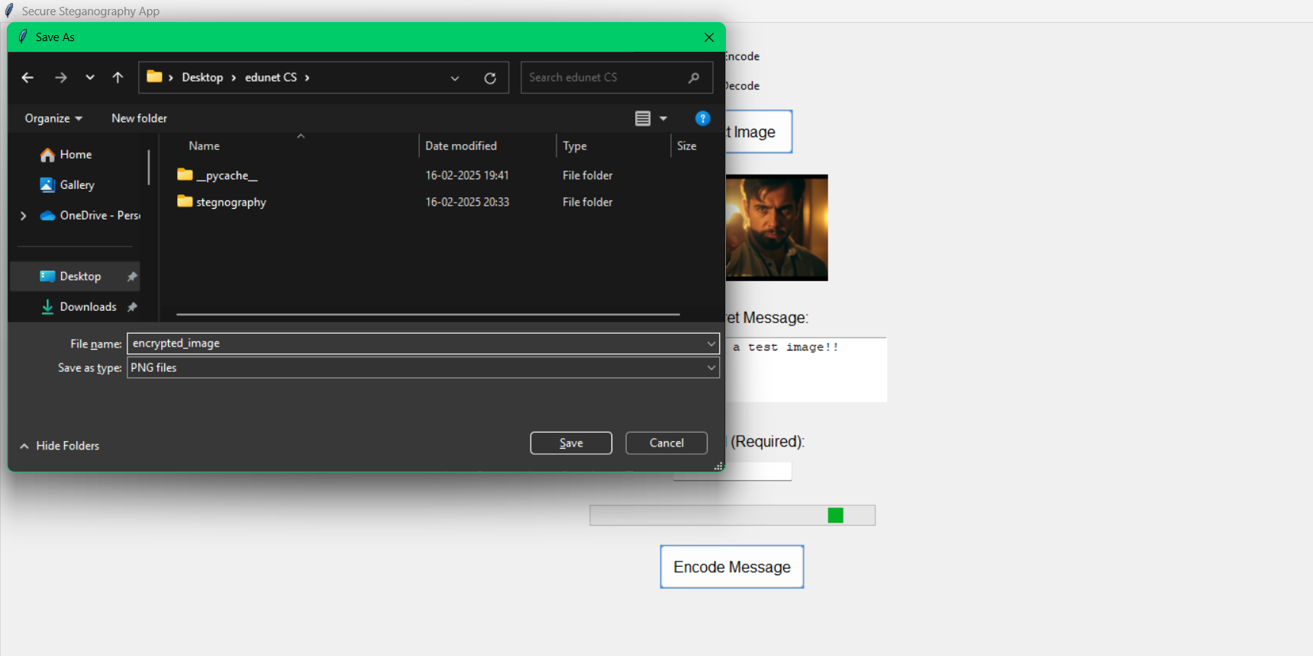
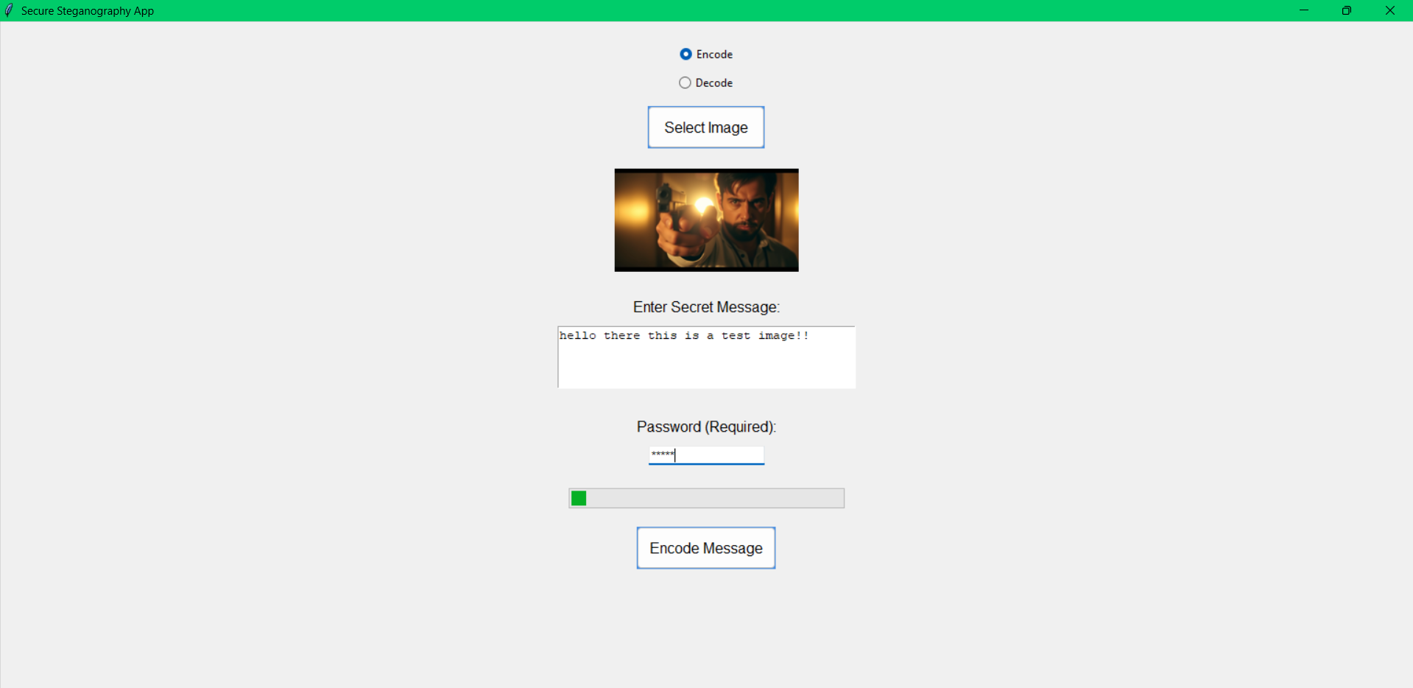
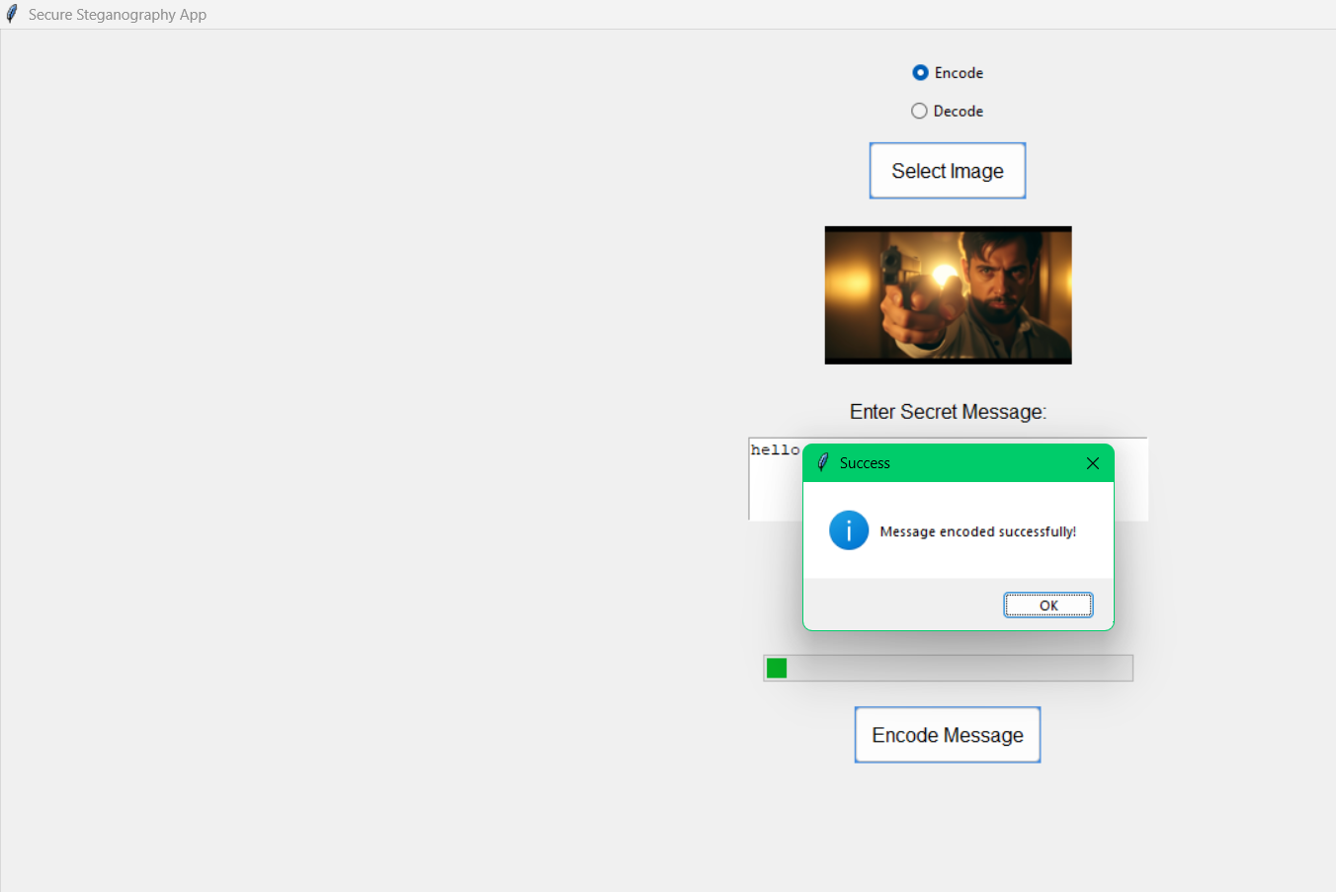
Results
Encryption

Slide 8
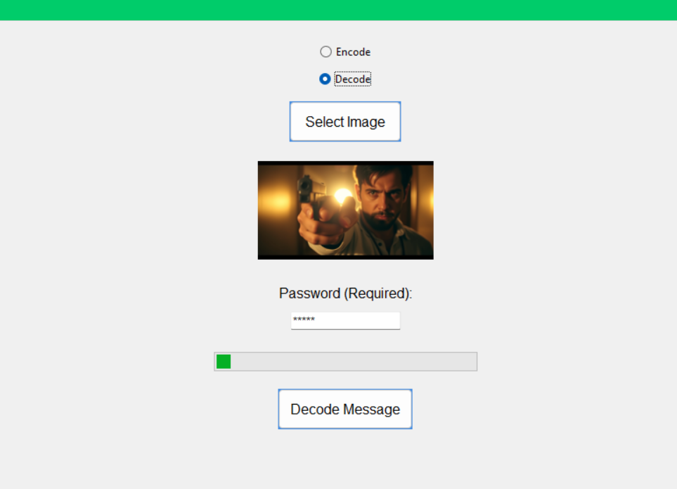
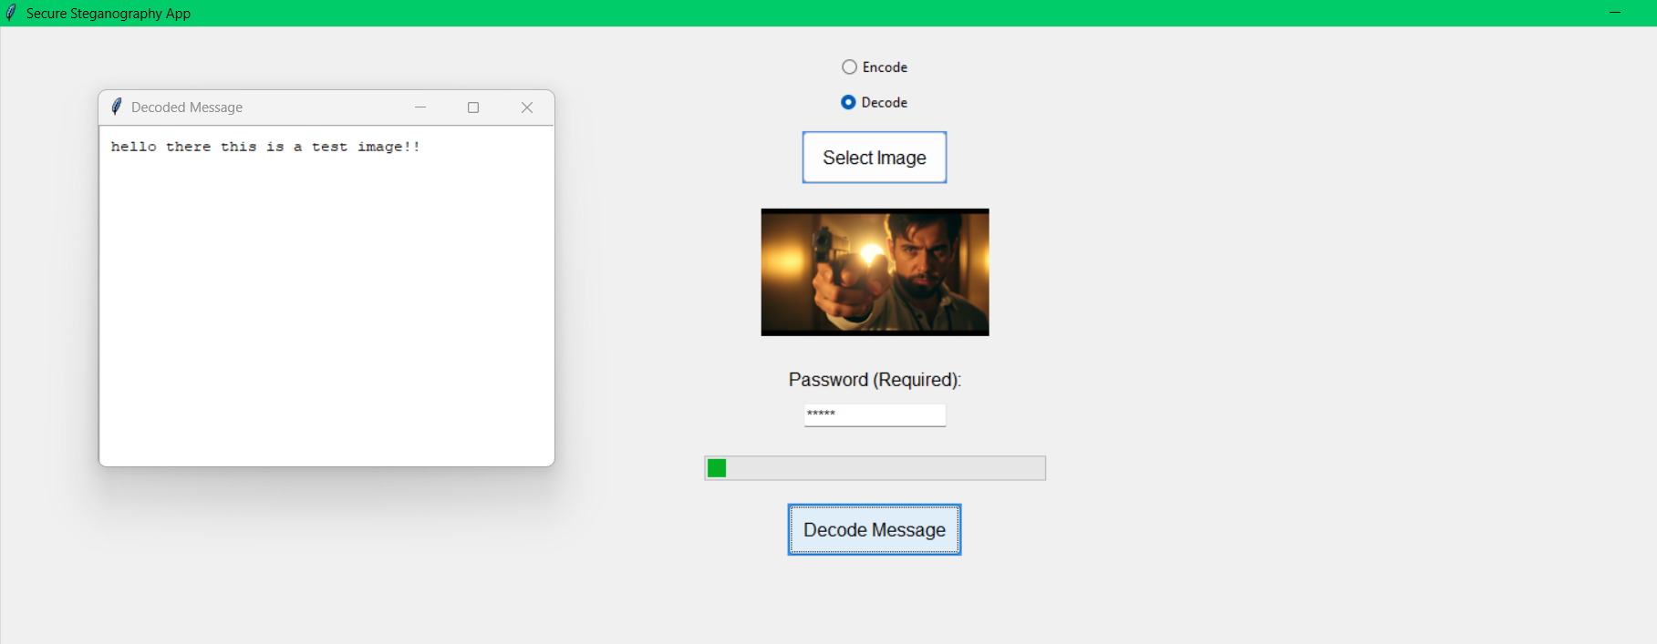
Results
Decryption

Slide 9
Conclusion
Achieved primary goal of secure data hiding
Implemented robust encryption and decryption
Created an intuitive user interface
Successfully combined steganography with cryptography
Developed a practical tool for secure communication

Slide 10
GitHub Link
https://github.com/Balaji77028/stegnography_aicte.git

Slide 11
THANK YOU

